Slide 1

Very low exposure simulator
Robin Jenkin | Ujwala Patil | March 2024

Slide 2
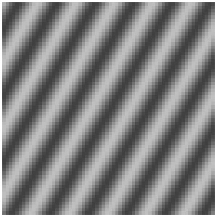
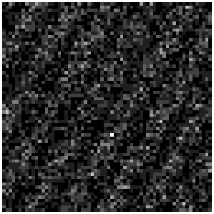
Output
Below is the reproduced output of the code that you had sent
Input image
Low light Image

Slide 3
Observations
A random number n is generated, and if n is less than or equal to p, it is assumed that a quantum is detected at that pixel, and the corresponding pixel in the simulated low light image ll is incremented by 1.
A random number n is generated, and if n is less than or equal to p, it is assumed that a quantum is detected at that pixel, and the corresponding pixel in the simulated low light image ll is incremented by 1.
A random number n is generated, and if n is less than or equal to p, it is assumed that a quantum is detected at that pixel, and the corresponding pixel in the simulated low light image ll is incremented by 1.
From your code, the following are our observations
Number of Quanta is fixed i.e 10000
The input image is generated by the cosine function i.e stored in the variable PP
The low exposure image function (P) is the same as the input image cosine function (PP)
Monte Carlo simulation is used to randomly select pixel position within the dimension of the image chosen and determine if a photon is detected based on a probability distribution.
A random number n is generated, and if n is less than or equal to p, it is assumed that a quantum is detected at that pixel, and the corresponding pixel in the simulated low light image is retained.

Slide 4
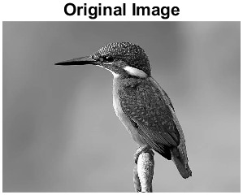
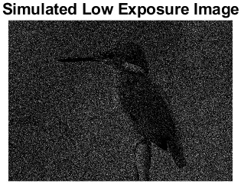
Experimentation:
Here we considered the number of quanta to be 2000000 (2 million)

Slide 5
Queries
Quanta number: How quanta number is being decided? In the code, the number of quanta is 10000.
Typically the number of quanta is estimated as,
Shall we proceed with the same?
3) What is the role of quanta per pixel in generating a low-exposure image?
4) In our given statement, KPI is to generate low-light distribution of photons as an image from a given luminance distribution image.
The distribution (ie PP) in the given code, is luminance distribution? or exposure distribution? Or something else?
Number of Quanta= Number of Pixels x Colours Depth x Exposure Time x Intensity of Light

